Slide 1

Operating system

Slide 2
Contents covered
S
Process states and life cycle
Kernel Vs User level threads
Process vs Threads
Multithreading
CPU scheduling concepts, metrics, methods

Slide 3
1. Process State LIFE CYCLE MODEL
As a process executes, it changes state
new: The process is being created.
ready: The process is waiting to be assigned to a processor.
running: Instructions are being executed.
waiting: The process is waiting for some event (I/O operations) to occur.
terminated: The process has finished execution.

Slide 4
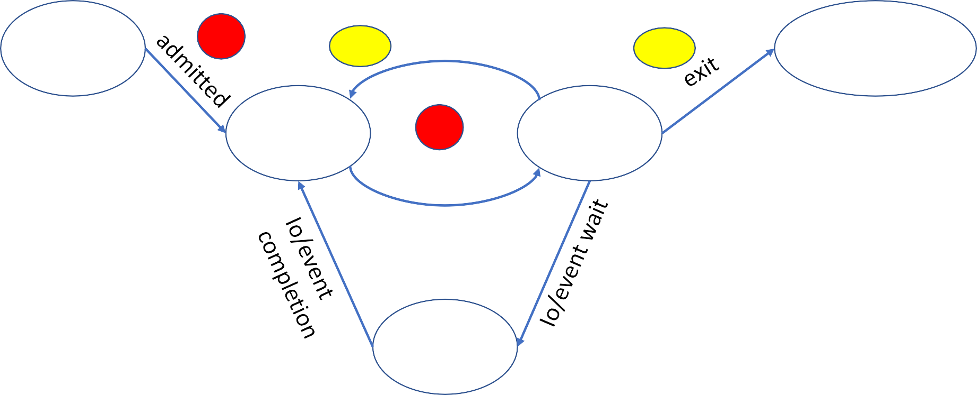
1. Process State LIFE CYCLE MODEL
new
1
Timeout/ interrupt
terminated
3.2
3.1
ready
2
Scheduler dispatch
running
waiting
3.3

Slide 5
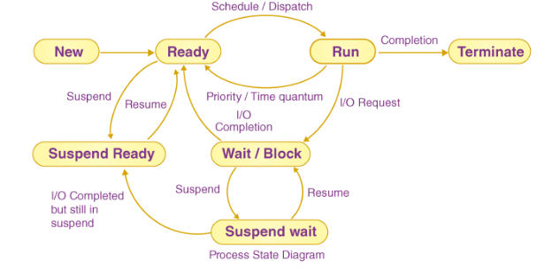
7 states process life cycle

Slide 6
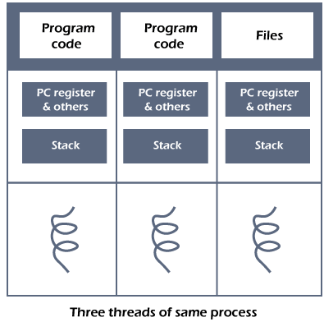
Threads in Operating System
Definition: A thread is the smallest unit of processing that can be performed in an OS.
Example: In a browser, many tabs can be viewed as threads. MS Word uses many threads - formatting text from one thread, processing input from another thread, etc.
Need of Thread:
It takes far less time to create a new thread in an existing process than to create a new process.
Threads can share the common data, they do not need to use Inter- Process communication.
Context switching is faster when working with threads.
It takes less time to terminate a thread than a process.
Why thread is called lightweight process: Each thread contains its own register and stack. However, thread share code, data and files, i.e. thread within a process share address space. Threads provide a way to improve application performance through parallelism.

Slide 7
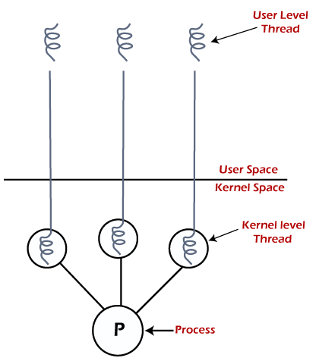
Two Types of Threads
User Level Threads The operating system does not recognize the user-level thread. User threads can be easily implemented and it is implemented by the user. Examples: Java thread, POSIX threads, etc.
Kernel Level Threads − The kernel-level thread is implemented by the operating system. The kernel knows about all the threads and manages them. Example: Window Solaris.
User threads are mapped to kernel threads by the thread library. The way this mapping is done is called the thread model.

Slide 8
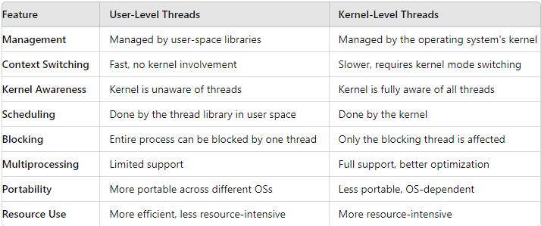

Slide 9
User and kernel level thread
Advantages of User Level Thread
Thread switching does not require Kernel mode privileges.
User level thread can run on any operating system and are fast to create and manage.
Disadvantages of User Level Thread
In a typical operating system, most system calls are blocking.
Multithreaded application cannot take advantage of multiprocessing
Advantages of Kernel Level Threads
Kernel can simultaneously schedule multiple threads from the same process on multiple processes.
If one thread in a process is blocked, the Kernel can schedule another thread of the same process.
Disadvantages of Kernel Level Threads
Kernel threads are generally slower to create and manage than the user threads.

Slide 10
Process vs Threads
Thread is an execution unit that is part of a process. A process can have multiple threads, all executing at the same time.
Parameter | Process | Thread
Definition | Process means a program is in execution. | Thread means a segment of a process.
Size | The process are heavyweight. | Threads are Lightweight.
Termination time | The process takes more time to terminate. | The thread takes less time to terminate.
Creation time | It takes more time for creation. | It takes less time for creation.
Communication | Communication between processes needs more time compared to thread. | Communication between threads requires less time compared to processes.
Context switching time | It takes more time for context switching. | It takes less time for context switching.
Resource | Process consume more resources. | Thread consume fewer resources.
Sharing | It does not share data | Threads share data with each other.

Slide 11
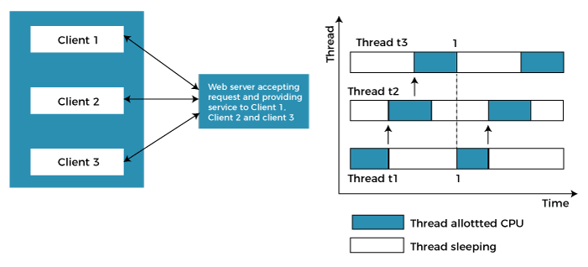
Multithreading in os
Multithreading allows the application to divide its task into individual threads. In multi-threads, the same process or task can be done by the number of threads, or we can say that there is more than one thread to perform the task in multithreading. With the use of multithreading, multitasking can be achieved.
The main drawback of single threading systems is that only one task can be performed at a time, so to overcome the drawback of this single threading, there is multithreading that allows multiple tasks to be performed.
Example: In this example client1, client2, and client3 are accessing the web server without any waiting. In multithreading, several tasks can run at the same time.

Slide 12
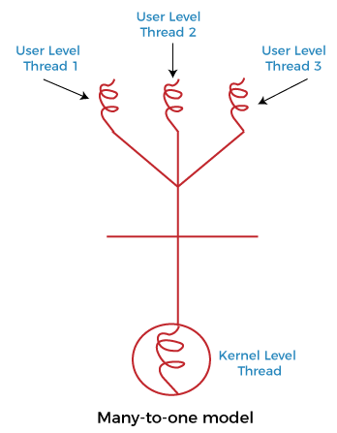
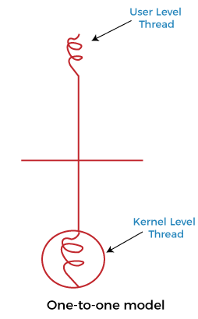
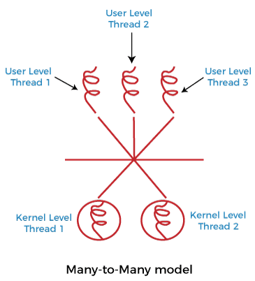
3 Types of Multithreading models
1. Many to one multithreading model: The many to one model maps many user levels threads to one kernel thread. This type of relationship facilitates an effective context-switching environment, easily implemented even on the simple kernel with no thread support.
2. One to one multithreading model: The one-to-one model maps a single user-level thread to a single kernel-level thread. This type of relationship facilitates the running of multiple threads in parallel.
3. Many to Many Model multithreading model: In this type of model, there are several user-level threads and several kernel-level threads. The number of kernel threads created depends upon a particular application. The developer can create as many threads at both levels but may not be the same.

Slide 13
CPU Scheduling
In Multiprogramming systems, the Operating system schedules the processes on the CPU to have the maximum utilization of it and this procedure is called CPU scheduling.
Scheduling: Scheduling is selecting the process to be executed next on the CPU. The Operating System uses various scheduling algorithm to schedule the processes.
This is a task of the short term scheduler to schedule the CPU from the number of processes present in the Job Pool. Whenever the running process requests some IO operation then the short term scheduler saves the current context of the process (also called PCB) and changes its state from running to waiting. During the time, process is in waiting state; the Short term scheduler picks another process from the ready queue and assigns the CPU to this process. This procedure is called context switching.
Why do we need Scheduling?
In Multiprogramming, if the long term scheduler picks more I/O bound processes then most of the time, the CPU remains idol. The task of Operating system is to optimize the utilization of resources.
If most of the running processes change their state from running to waiting then there may always be a possibility of deadlock in the system. Hence to reduce this overhead, the OS needs to schedule the jobs to get the optimal utilization of CPU and to avoid the possibility to deadlock.

Slide 14
When CPU Scheduling is Done?
CPU scheduling decisions may take place under the following four circumstances:
When a process switches from the running state to the waiting state. For example, I/O request, or invocation of the wait for the termination of one of the child processes.
When a process switches from the running state to the ready state. For example, when an interrupt occurs.
When a process switches from the waiting state to the ready state. For example, completion of I/O.
When a process terminates.

Slide 15
Types of CPU Scheduling
There are two kinds of CPU Scheduling techniques:
1. Non-preemptive Scheduling: Here when a process is allocated CPU, it keeps the processor with it till it releases the processor voluntarily either by reaching to terminating state or waiting for the state. 2. Preemptive Scheduling: In preemptive scheduling, the CPU can be taken back from the process at any time during the execution of the process When scheduling is Preemptive or Non-Preemptive?
To determine if scheduling is preemptive or non-preemptive, consider these four parameters:
A process switches from the running to the waiting state.
Specific process switches from the running state to the ready state.
Specific process switches from the waiting state to the ready state.
Process finished its execution and terminated.

Slide 16
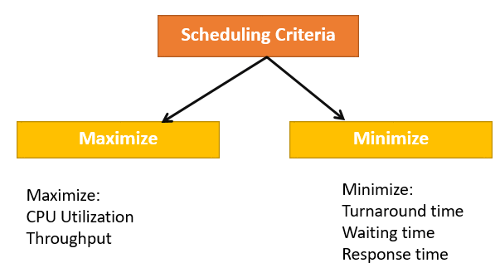
metrics to measure performance of a CPU scheduling algo
Comparing the CPU scheduling algorithms, includes:
CPU utilization - CPU should be kept as busy as possible
Throughput - Number of processes completed per unit time is called throughput.
Turnaround time - The interval from the time of submission of a process to the time of completion is the turnaround time. Turnaround time is the sum of the periods spent waiting to get into memory, waiting in the ready queue, executing on the CPU, and doing I/O.
Waiting time - Waiting time is the sum of the period spent waiting in the ready queue.
Response time - Response time is the time from the submission of a request until the first response is produced.

Slide 17
Types of CPU scheduling Algorithm
There are mainly seven types of process scheduling algorithms
First Come First Serve (FCFS)
Shortest-Job-First (SJF) Scheduling
Shortest Remaining Time (SRTF)
Priority Scheduling
Round Robin Scheduling
Highest Response Ratio Next (HRRN)
Lottery scheduling

Slide 18
Thank You

